Slide 1


Project Presentation
Collecting information from sensors
Using drone and LoRaWAN protocol

Slide 2
Background
LoRaWAN is a point-to-multipoint networking protocol that uses Semtech’s LoRa modulation scheme which is designed for long range, low power wide area networks with low cost, mobility, security and bidirectional communication.
LoRaWAN has three classes that operate simultaneously. Each differs from the other by the amount of power its operation requires.
LoRa works by moving an RF tone around over time in a very linear way.
LoRa transmissions work by chirping, breaking the chips in different places in terms of time and frequency in order to encode a symbol.

Slide 3
Motivation
The GW is physically connected to the drone, the sensors are scattered across a large polygonal area and the server is offline until the drone returns and unloads the data.
We need a protocol that allows:
Long range communication
Low power usage
Synchronized for usage with multiple end nodes
LoRaWAN is the best wireless protocol solution for our task!

Slide 4
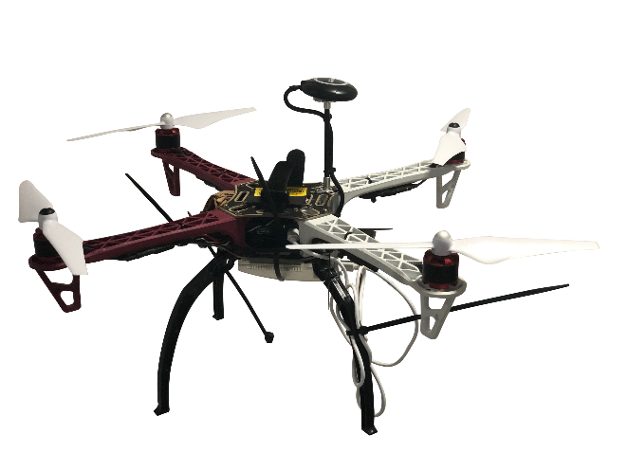
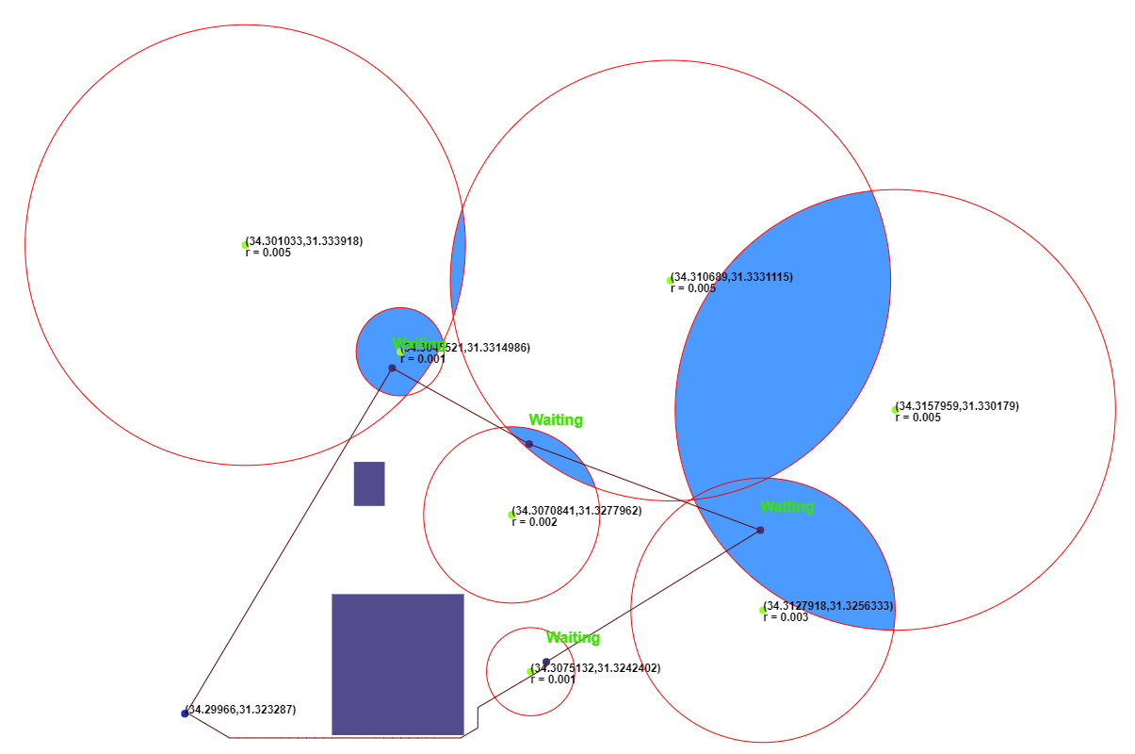
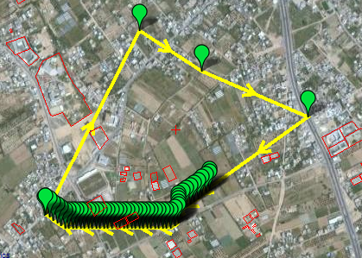
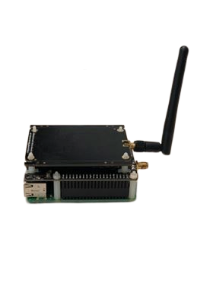
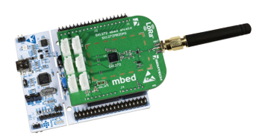

Architecture – High level
Path Planning
Mission Planner
Drone
LoRaWAN Server
LoRaWAN GW
LoRaWAN Sensors

Slide 5
Project Targets & Solution
Learn
Learn about LoRa and LoRaWAN protocols while getting practical experience in modifying said protocols for our purpose.
Modify
Allow GW to store packets received from sensors and then unload them to server via Ethernet.
Create
Create a smart path planning algorithm for the drone to collect data from multiple scattered sensors with different signal radii.
Experiment
Do live experiments of flying the drone to confirm that said algorithm works and that data from sensors has successfully been gathered.

Slide 6

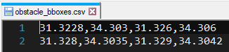
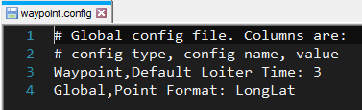
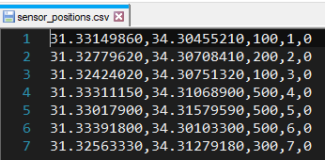
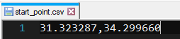
Solution – Path Planning (1)
Path planning algorithm receives an input of:
Start point
Sensor points and their metadata (signal radii, SNR and ID)
Obstacle bboxes
External config file

Slide 7
Solution – Path Planning (2)
Using Python we generate a .waypoint file to be read and processed by mission planner
Using Python and JavaScript we generate an animated simulation of the path of the drone in 2d.

Slide 8

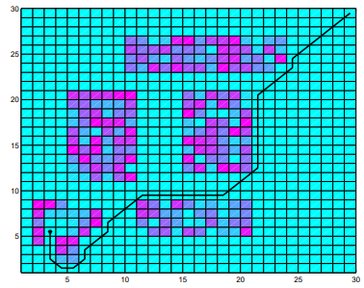



Solution – Path Planning (3) Explaining the algorithm

Slide 9
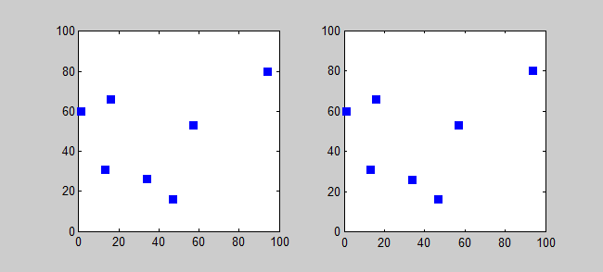
Planning the order
Two algorithms have been implemented:
Greedy algorithm
Traveling salesman
The greedy algorithm works very fast but doesn’t guarantee optimal result
Traveling salesman is an exponential time algorithm but gives the optimal result.

Slide 10
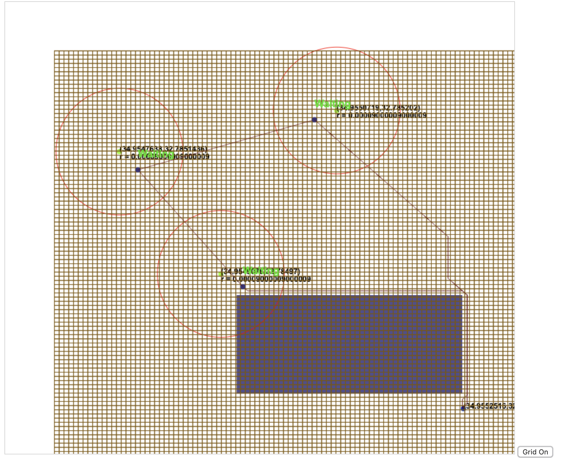
Planning the Path
To avoid obstacles we used a Dijkstra algorithm over a grid.
A square in the grid represents a node
Two neighboring squares represent an edge in the graph
A path is discarded if it contains an edge intersecting an obstacle

Slide 11
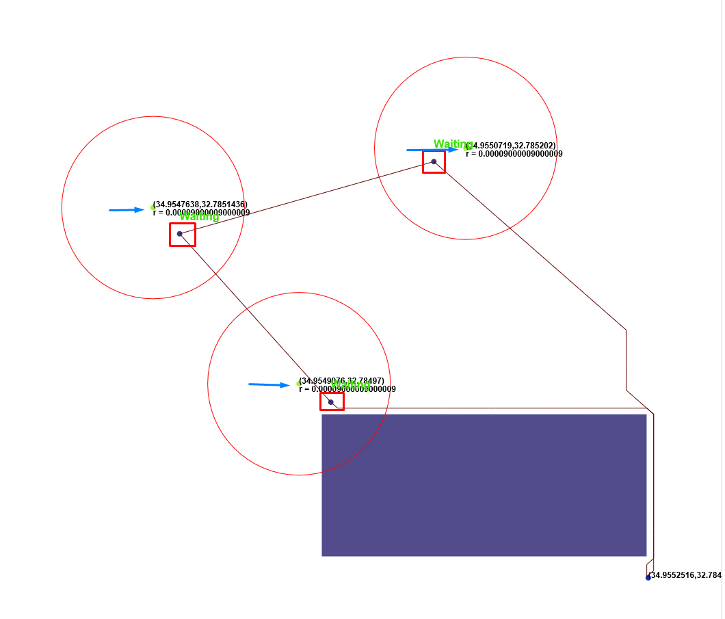
Optimizations
In order to utilize the radii to improve the path, our algorithm searches for optimal path that cuts the radii
The algorithm is dynamic!
Parameters such as grid size, stopping point inside the radius, etc are dynamic within the code and can be easily changed manually.
Depending on the circumstances we would want to play with algorithm parameters to optimize the path or optimize the runtime.

Slide 12
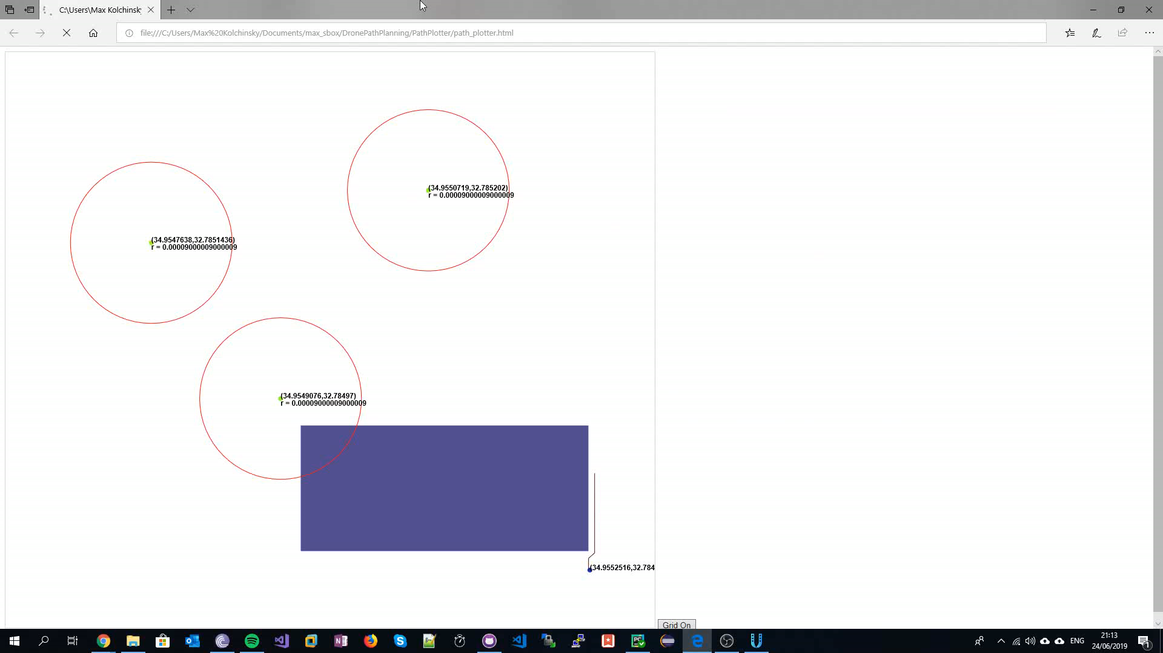
Solution – Path Planning Simulation

Slide 13
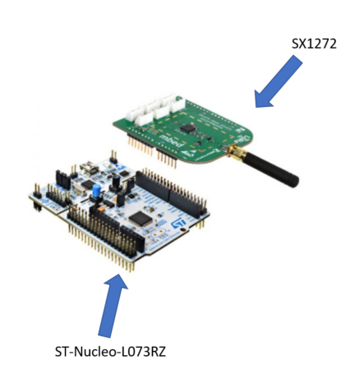
Solution – Sensors
Two connected HW components:
STM Nucleo L073RZ:
192KB flash
20KB SRAM
Semtech SX1272:
LoRa RF transceiver.

Slide 14
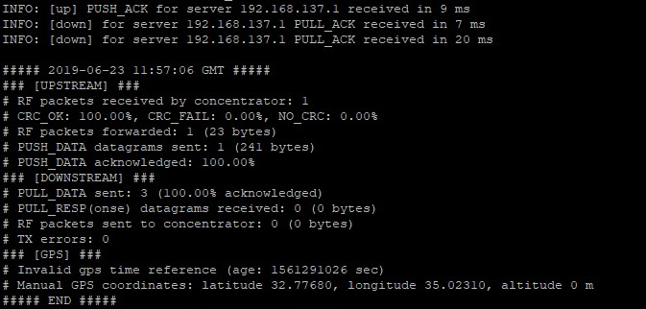
Solution – SW and HW Gateways
We used
Raspberry Pi with Semtech sx1272 LoRa transceiver for the HW Gateway
iC880a-based SW GW for the SW Gateway

Slide 15

Solution – From Sensors to Gateway
We need to send the data from the sensors to the gateway mid flight.
Current SW allows to send data from sensor to gateway only when the server is on
Server is offline (out of range) and SW Gateway cannot forward the packets directly.
We updated packet forwarding mechanism of SW Gateway to enable storing the packets offline.
+
Gateway
Drone
LoRa Frequency 868.1 MHZ
LoRaWAN Sensor

Slide 16

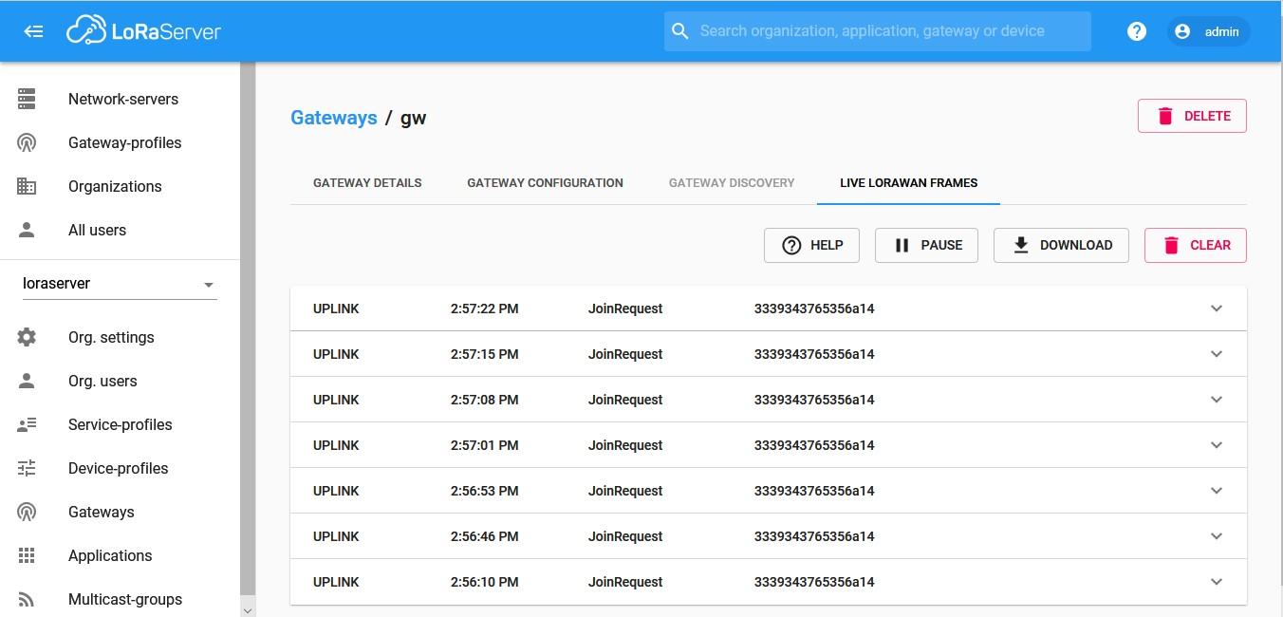
Solution – From Gateway to Server
We used open source
SW Gateway is constantly trying to reach server.
Once it connects to the server, it forwards all unsent packets received during the flight.

Slide 17
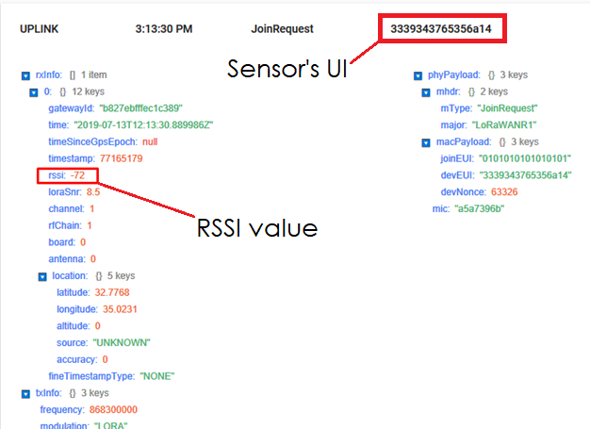
Solution – Analysis and signal radii update after a flight
First flight assumes signal radius of 0. Each successor flight will update it based on analysis.
Able to detect both UI and RSSI after getting the data from the server
Able to detect packet sender by UI
Signal radii can be updated using packet RSSI+UI
Accurate radius will result in optimal path while still being able to collect all the data.

